Slide 1


BRAIN TUMOR CLASSIFICATION & SEGMENTATION

Slide 2


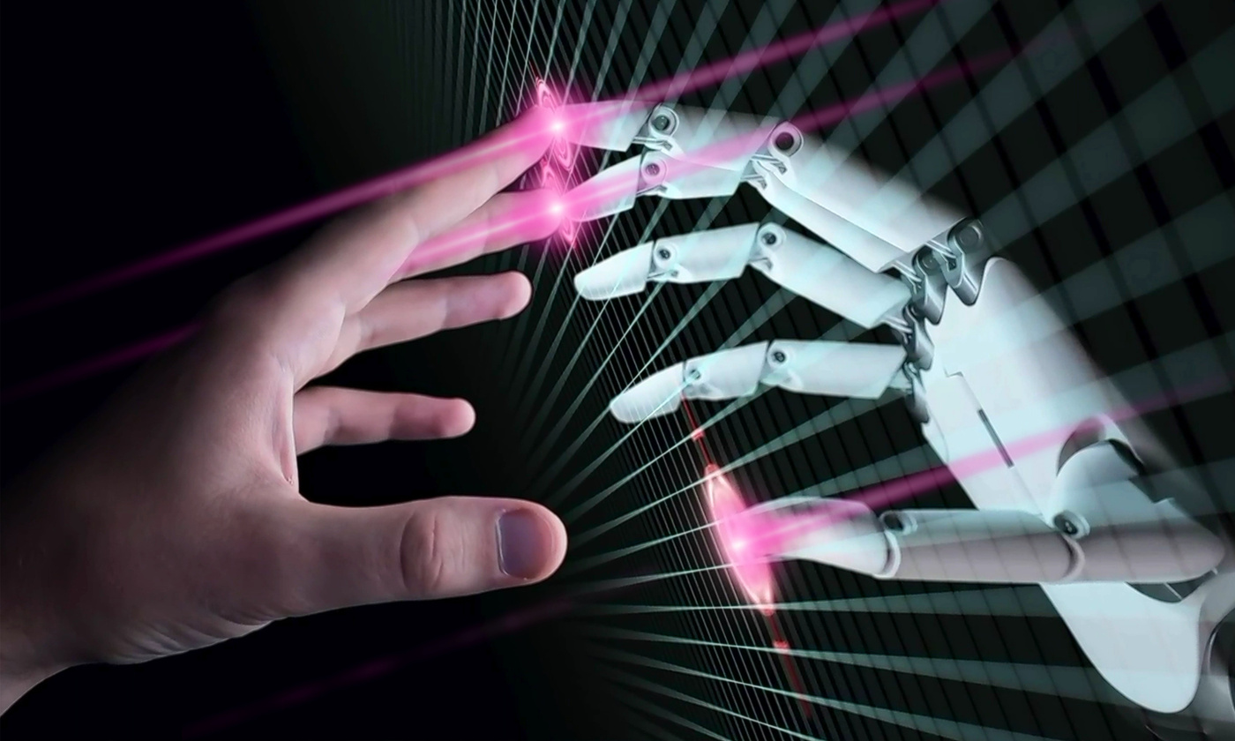
STUDIO SHODWE
INTRODUCTION
Project objective: Classifying brain tumor types and segmenting tumor regions from MRI images.
Importance of the project: Assisting physicians in rapid diagnosis and accurate analysis of brain images.

Slide 3

DATASETOVERVIEW
Content: Data Source: Kaggle Brain MRI dataset
Number of Images: ... 3929)
Number of Masks:... 3929)
1
Tumor Types: Glioma, Meningioma, Pituitary, No Tumor
Image Format: JPG/PNG, RGB
Example Images for Each Class
2

Slide 4
DATA PREPROCESSING
Content: - Resize Classification: 224x224
- Resize Segmentation: 224x224
- Normalize values between 0-1
- Convert images to numpy arrays
1

Slide 5

STUDIO SHODWE
MODEL ARCHITECTURE
Content: Classification Model:
- Model Type: CNN
- Input: 224x224x3
- Output: 4 classes
Segmentation Model:
- Model Type: U-Net
- Input: 224x224x3
- Output: binary mask

Slide 6

TRAINING STEPS
TRAIN/TEST/VALIDATION
CODE WORKFLOW
- Preprocess image
- Predict classification
- Predict segmentation
- Overlay mask on image
- Display results in Streamlit
-Number of epochs and batch size
- Optimizer used
-Data augmentation if present

Slide 7


DEPLOYMENT WITH STREAMLIT
- VIEW THE ORIGINAL IMAGE
- View the resulting mask
- View the overlay
- Lottie animation to enhance the user experience
- Progress bar to load the results

Slide 8

STUDIO SHODWE
NEXT STEPS
Content: - Train on larger dataset
- Better data augmentation
- Show probabilities for all classes
- Combine classification and segmentation into one model.

Slide 9

REFERENCES
DATASET : KAGGLE
- Libraries: TensorFlow, Keras, Streamlit, OpenCV, PIL
THANK YOU

